Slide 1
Bayesian Networks Classifiers

Slide 2
Naïve Bayes Performance
NB is one of more simple and effective classifiers
NB has a very strong unrealistic independence assumption:
all the attributes are conditionally independent given the value of class
in practice: independence assumption is violated ⇒ HIGH BIAS
it can lead to poor classification
However, NB is efficient due to its high variance management
less parameters ⇒ LOW VARIANCE
Notes:
Naïve-Bayes has been used as an effective classifier for many years. Unlike many other classifiers, it is easy to build and learn very quickly. However, Naïve-Bayes has a very strong independence assumption which can bias the model. NB assumes that all the attributes are independent of each other. In practice this independence assumption is violated. However, as it was shown in many works, Naïve-Bayes has surprisingly outperformed many sophisticated classifiers over a large number of datasets, especially if the attributes are not strongly correlated.
So, although NB has a high bias due to its strong feature independence assumptions, its performance is compensated by its high variance management, thus producing accurate classification.

Slide 3

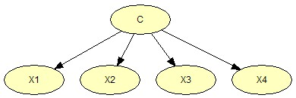
Improving Naïve Bayes
reducing the bias of the parameter estimates
by improving the probability estimates computed from data
Relevant works:
Web and Pazzani (1998) - “Adjusted probability naive Bayesian induction” in LNCS v 1502
J. Gama (2001, 2003) - “Iterative Bayes”, in Theoretical Computer Science, v. 292
reducing the bias resulting from the modeling error
by relaxing the attribute independence assumption
one natural extension: Bayesian Network Classifiers
Friedman, Geiger and Goldszmidt (1998) “Bayesian Network Classifiers” in Machine Learning, 29
Pazzani (1995) - “Searching for attribute dependencies in Bayesian Network Classifiers” in Proc. of the 5th Workshop of Artificial Intelligence and Statistics
Keogh and Pazzani (1999) - “Learning augmented Bayesian classifiers…”, in Theoretical Computer Science, v. 292
Relevant works:

Slide 4
Bayesian Networks Classifiers
Part II - Introduction to Bayesian Networks

Slide 5
Reasoning under Uncertainty Probabilistic Approach
A problem domain is modeled by a set of random variables X₁, X₂ . . . , X_{n}
Knowledge about the problem domain is represented by a joint probability distribution P(X₁, X₂, . . . , X_{n})
Example: ALARM network (Pearl 1988)
Story: In LA, burglary and earthquake are not uncommon. They both can cause alarm. In case of alarm, two neighbors John and Mary may call
Problem: Estimate the probability of a burglary based who has or has not called
Variables: Burglary (B), Earthquake (E), Alarm (A), JohnCalls (J), MaryCalls (M)
Knowledge required by the probabilistic approach in order to solve this problem: P(B, E, A, J, M)
Notes:
The probabilistic approach to reasoning under uncertainty
A problem domain is modeled by a list of variables X1, X2, . . . , Xn,
Knowledge about the problem domain is represented by a joint probability
P(X1, X2, . . . ,Xn).
Example: Alarm (Pearl 1988)
Story: In LA, burglary and earthquake are not uncommon. They both can
cause alarm. In case of alarm, two neighbors John and Mary may call.
Problem: Estimate the probability of a burglary based who has or has not
called.
Variables: Burglary (B), Earthquake (E), Alarm (A), JohnCalls (J),
MaryCalls (M).
Knowledge required by the probabilistic approach in order to solve this
problem:
P(B, E, A, J,M)

Slide 6
Example: Alarm Network (Pearl) Inference with Joint Probability Distribution

Slide 7
Example: Alarm Network (Pearl) Joint Probability Distribution
We need to define 2⁵-1= 31 probabilities

Slide 8
Inference with Joint Probability Distribution
To specify P(X₁, X₂, . . . , X_{n})
we need at least 2^{n} − 1 numbers probability
⇒
exponential model size.
Knowledge acquisition difficult (complex, unnatural)
Exponential storage and inference
Solution:
by exploiting conditional independence we can obtain an appropriate factorization of the joint probability distribution ⇒ the number of parameters could be substantially reduced
A good factorization is provided with Bayesian Networks
Notes:
P(X1, X2, . . . ,Xn) needs at least 2n − 1 numbers to specify the joint
probability. Exponential model size.
Knowledge acquisition difficult (complex, unnatural),
Exponential storage and inference.

Slide 9
Bayesian Networks
Pearl (1988, 2000); Jensen (1996); Lauritzen (1996)
Bayesian Networks (BNs) graphically represent the joint probability distribution of a set X of random variables in a problem domain
A BN=(S, Θ_{S}) consist in two components:
Graph theory
Probability theory
Wet grass BN from Hugin
Qualitative part
Quantitative part
the structure S - a Directed Acyclic Graph (DAG)
nodes – random variables
arcs - direct dependence between variables
the set of parameters Θ_{S} = set of conditional probability distributions (CPDs)
discrete variables: Θ_{S} - multinomial (CPDs are CPTs)
continuos variables: Θ_{S} - Normal ou Gaussiana
Markov condition :
each node is independent of its non descendants given its parents in S
⇒ The joint distribution is factorized

Slide 10
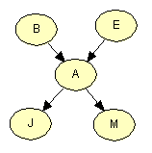

Example: Alarm Network (Pearl) Bayesian Network
X = { B - Burglary, E- Earthquake, A - Alarm, J - JohnCalls, M – MaryCalls }
The Bayesian Network has two components:
the structure – a Directed Acyclic Graph
the parameters – a set of conditional probability tables (CPTs)
⇒ pa(B) = { }, pa(E) = { }, pa(A) = {B, E}, pa(J) = {A}, pa(M) = {A}
P(B) P(E) P(A | B, E) P(J | A) P( M | A}
Model size reduced from 31 to 1+1+4+2+2=10
Notes:
each θijk is the probability P(Xi = k | Pai = j) for each possible
value xki
in ΩXi

Slide 11
Example: Alarm Network (Pearl) Factored Joint Probability Distribution
X = {B (Burglary), (E) Earthquake, (A) Alarm, (J) JohnCalls, (M) MaryCalls}
P(B, E, A, J, M) = P(B) P(E) P(A|B, E) P(J|A) P(M|A)
Notes:
each θijk is the probability P(Xi = k | Pai = j) for each possible
value xki
in ΩXi

Slide 12
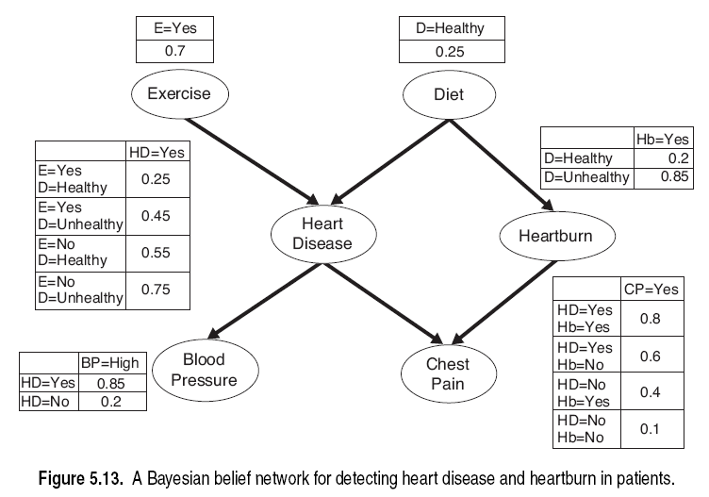
Bayesian Networks Another Example with Binary Variables
P(HeartDisease=“No”|Exercise=“no”, Diet =“Healthy”) = 1 - P(HeartDisease=“Yes”|Exercise=“no”, Diet =“Healthy”) =1- 0.55 = 0.45
P(HeartBum=“yes”| Dieta=“Healthy”) = 0.2
tensão
dor no peito

Slide 13
Inference in Bayesian Networks
Compute the posterior probability distribution for a set of query variables, given values for some evidence variables
Diagnostic inferences: from effect to causes P(Burglary|JohnCalls)
Causal Inferences: from causes to effects
P(JohnCalls|Burglary)
P(MaryCalls|Burglary)
Intercausal Inferences: between causes of a common effect
P(Burglary|Alarm)
P(Burglary|Alarm Earthquake)
Mixed Inference: combining two or more of above.
P(Alarm|JohnCalls EarthQuake)
P(Burglary|JohnCalls EarthQuake)
P(Q | E ) = ?
Picture taken from Ann Nicolson Lecture 2: Introduction to Bayesian Networks
Notes:
Diagnostic inferences: from effect to causes.
P(Burglary|JohnCalls)
Causal Inferences: from causes to effects.
P(JohnCalls|Burglary)
P(MaryCalls|Burglary)
Intercausal Inferences: between causes of a
common effect.
P(Burglary|Alarm)
P(Burglary|Alarm Earthquake)
Mixed Inference: combining two or more of above.
P(Alarm|JohnCalls EarthQuake)
P(Burglary|JohnCalls EarthQuake)

Slide 14
Bayesian Network Resources
Repository: www.cs.huji.ac.il/labs/compbio/Repository/
Softwares:
Genie: genie.sis.pitt.edu
Hugin: www.hugin.com
Analytica: www.lumina.com
JavaBayes: www.cs.cmu.edu/ javabayes/Home/
Bayesware: www.bayesware.com
BN info sites
Bayesian Belief Network site (Russell Greiner)
Summary of BN software and links to software sites (Kevin Murphy)

Slide 15
Bayesian Networks: Summary
Bayesian Networks: an efficient and effective representation of the joint probability distribution of a set of random variables
Efficient:
Local models
Independence (d-separation)
Effective: Algorithms take advantage of structure to
Compute posterior probabilities
Compute most probable instantiation
Decision making
But there is more: statistical induction  LEARNING
adapted from © 1998, Nir Friedman, U.C. Berkeley, and Moises Goldszmidt, SRI International. All rights reserved.
Notes:
Bayesian Networks (BNs) graphically represent the joint probability distribution of a set X of random variables in a problem domain

